Slide 1
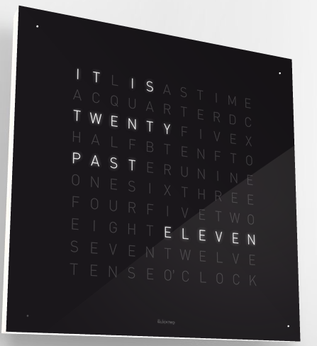
Whole clock: 17.75” square
Text: ~ 11” wide

Slide 2
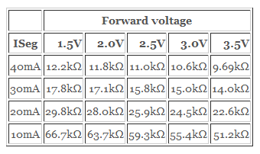

I think that I bought 22kohm resistors.
So, 20 mA * 8 LEDs = 160 mA
+ 10 mA = 170 mA max per LED driver
On re-evaluation, buy some 18k resistors.
So, ~27 mA * 8 LEDs = 216 mA + 10 mA = 226 mA max per LED driver

